Slide 1
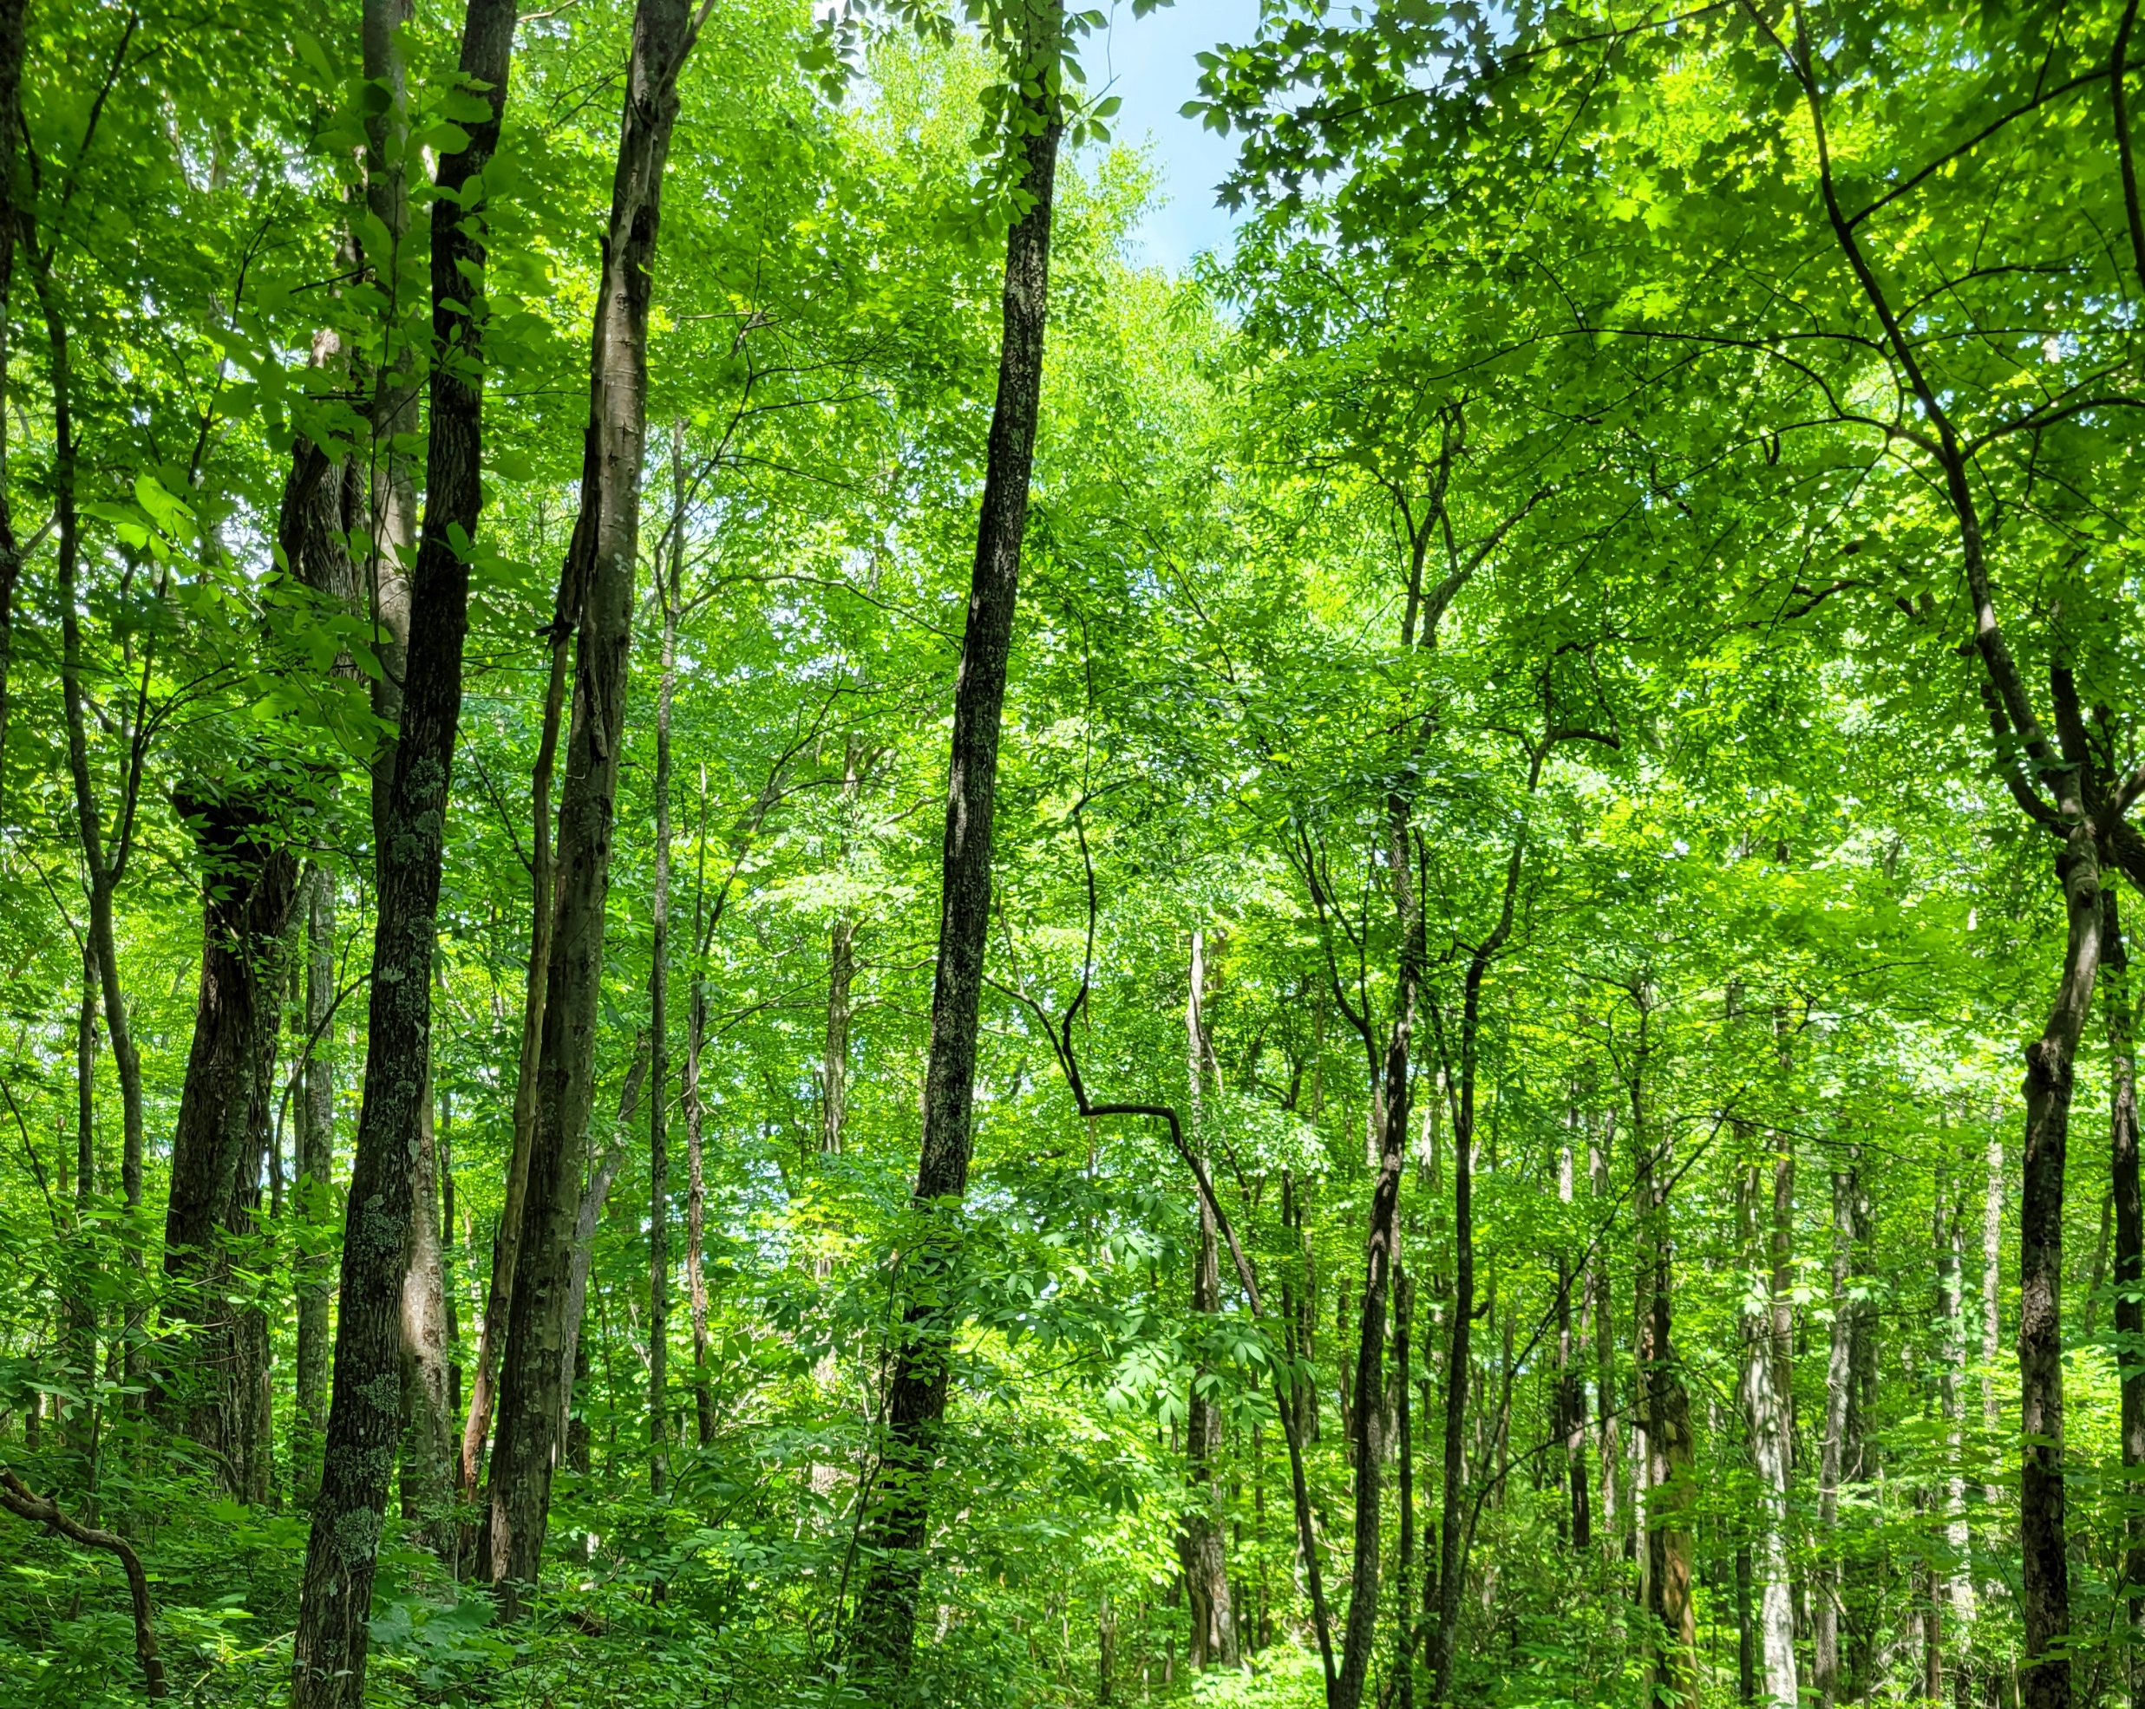
Regulation and modeling nonstructural carbohydrate dynamics
Scott W Oswald, Doug P. Aubrey, Dan M. Ricciuto, Jeff M. Warren
Ecological Society of America, Montréal, QC
August 18, 2022

Slide 2
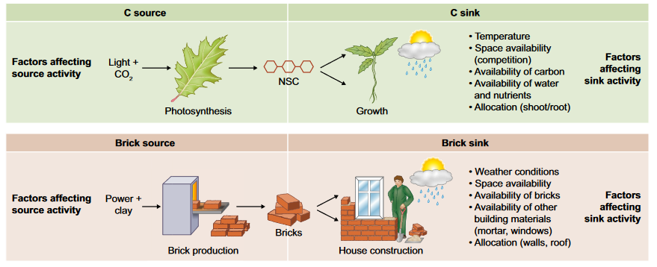
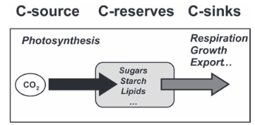
Fig 1. Fatichi et al. 2019
Nonstructural Carbohydrates = NSC
Sala et al. 2011; Sala et al. 2012

Slide 3
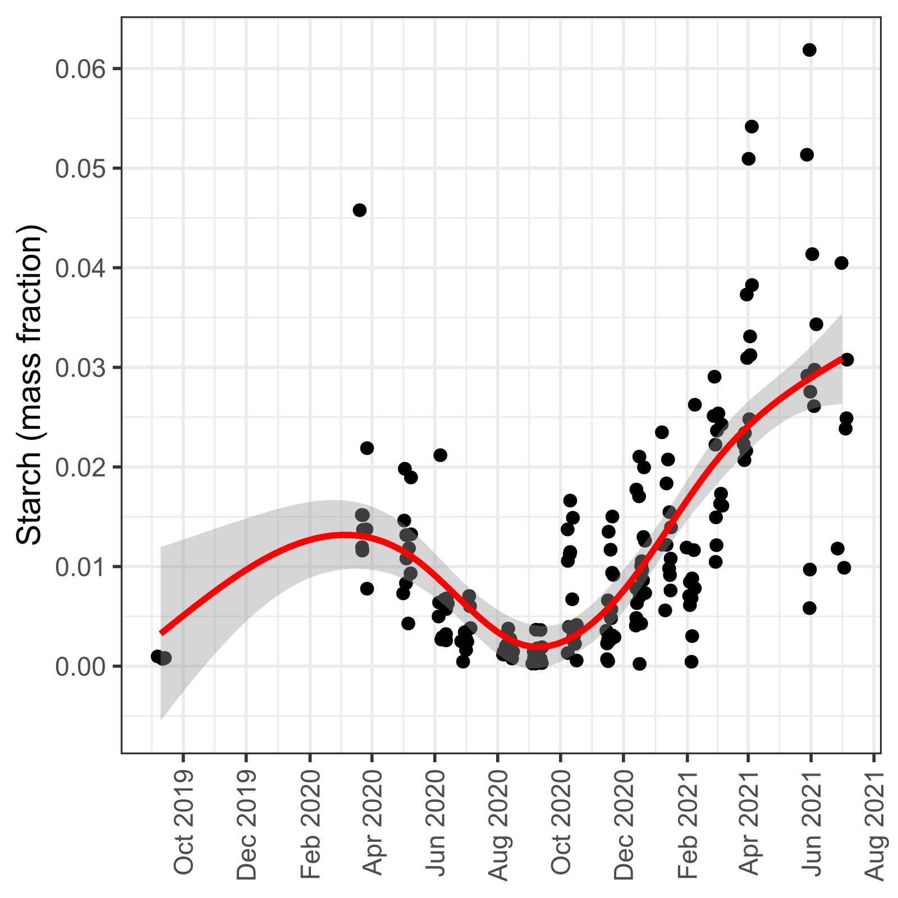
From here to there…
Loblolly Pine Saplings (Pinus taeda)

Slide 4
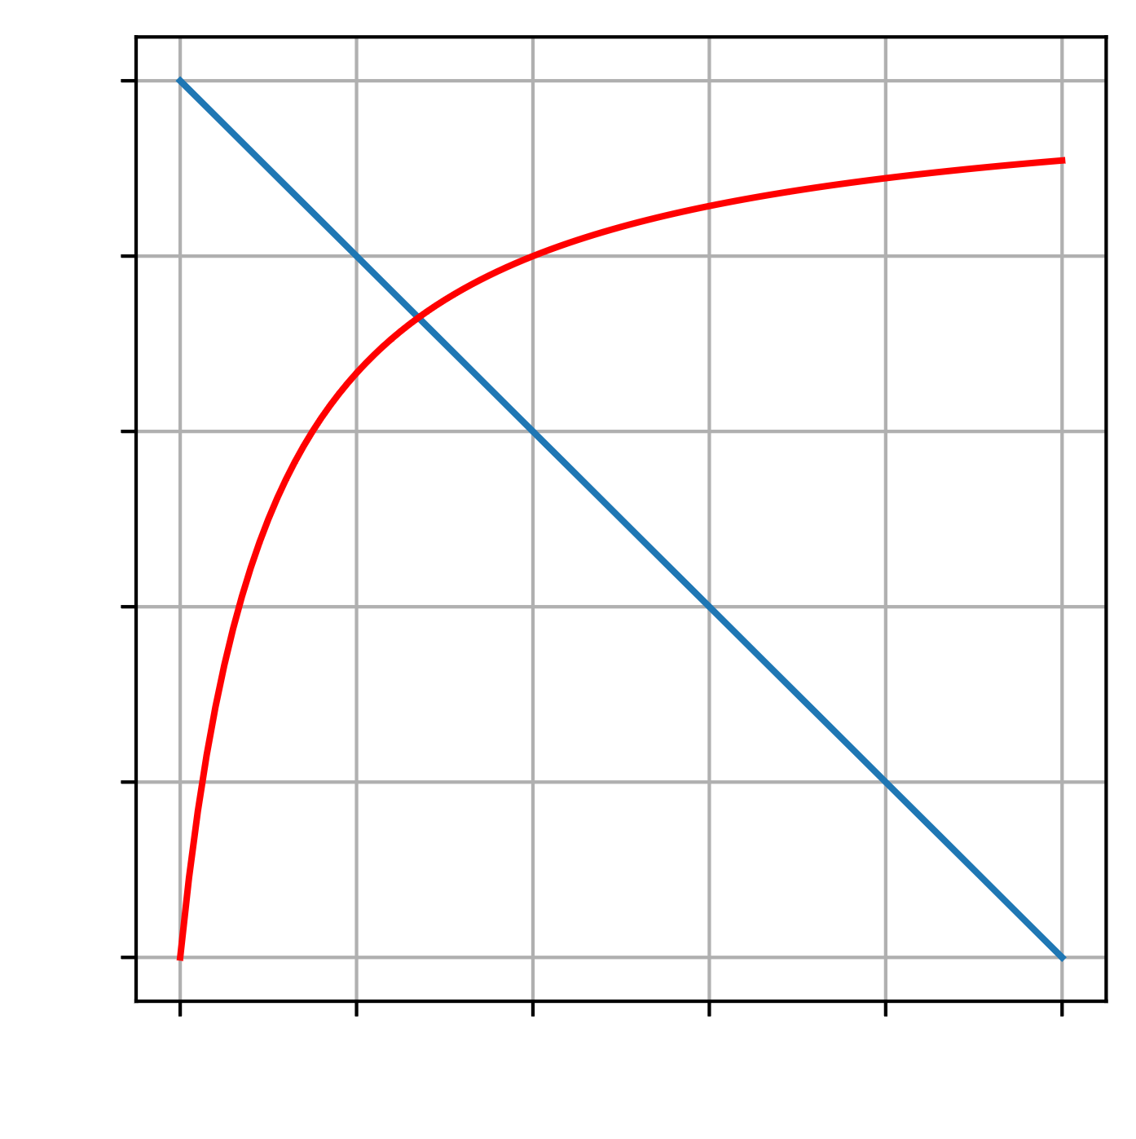
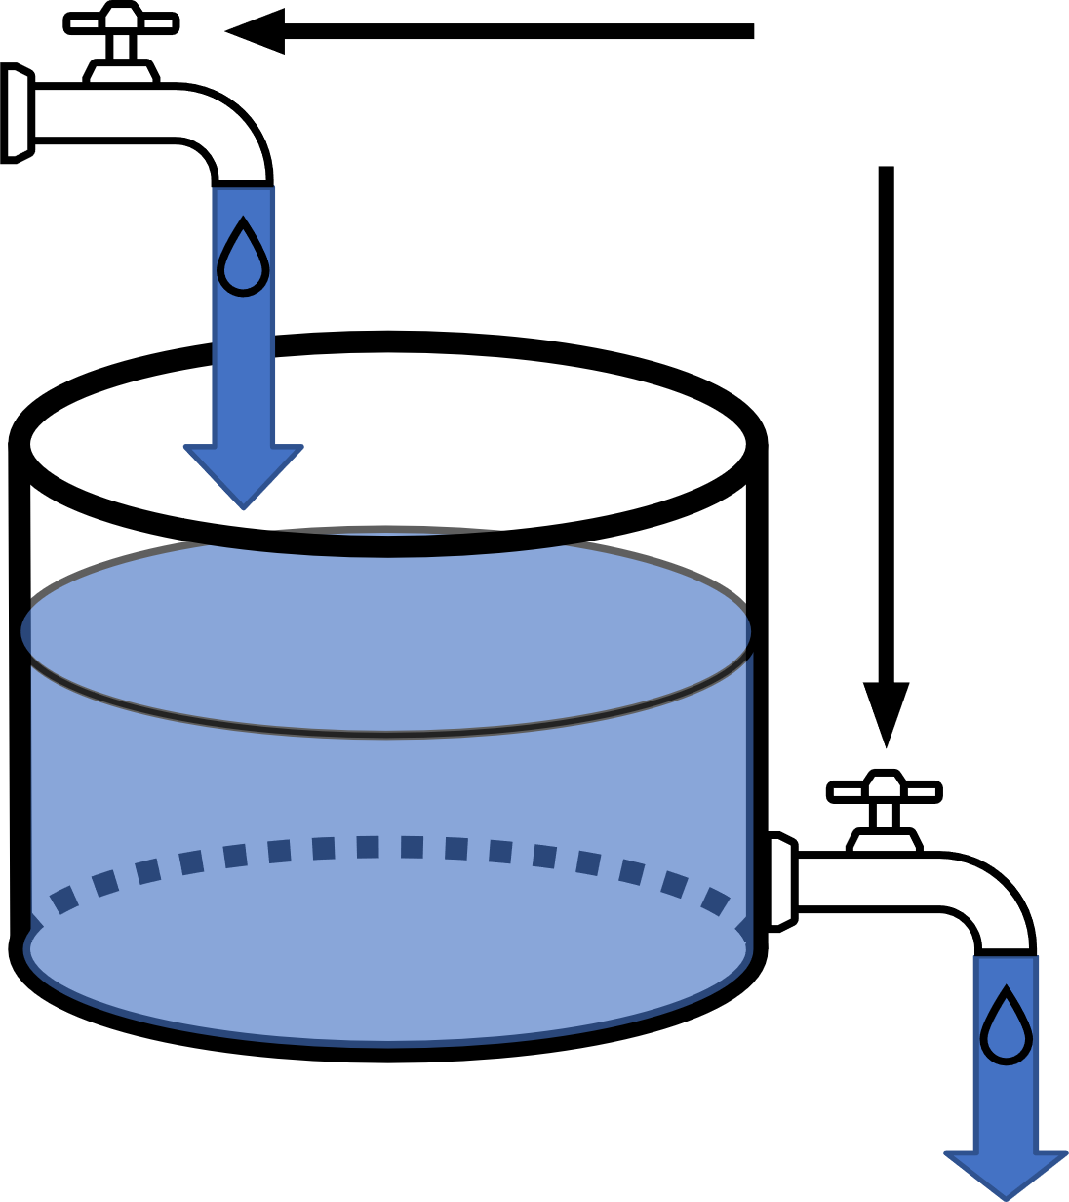
Photosynthesis = NSC supply
Demand Rate
Adjustable
Rate
Supply Rate
NSC
Respiration + Growth = NSC Demand
NSC

Slide 5
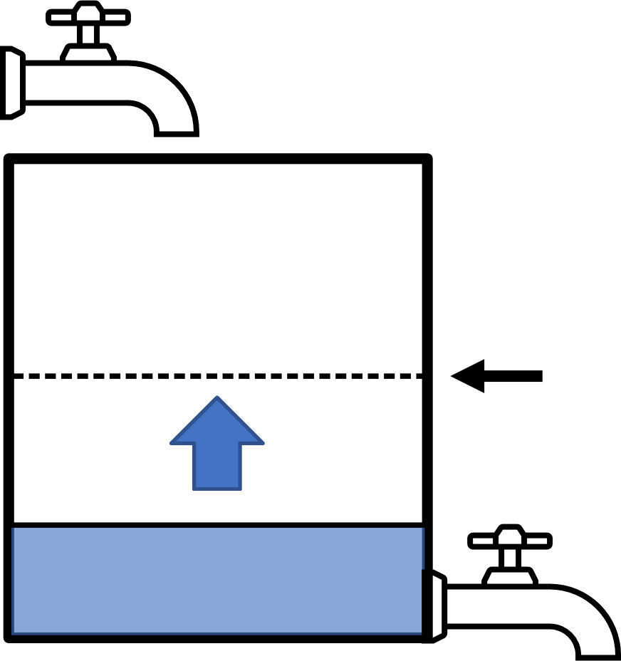
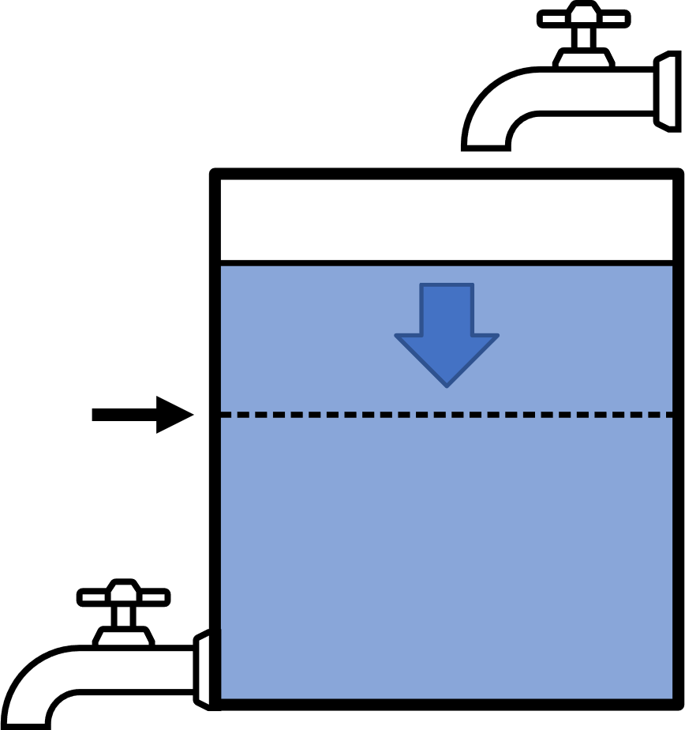
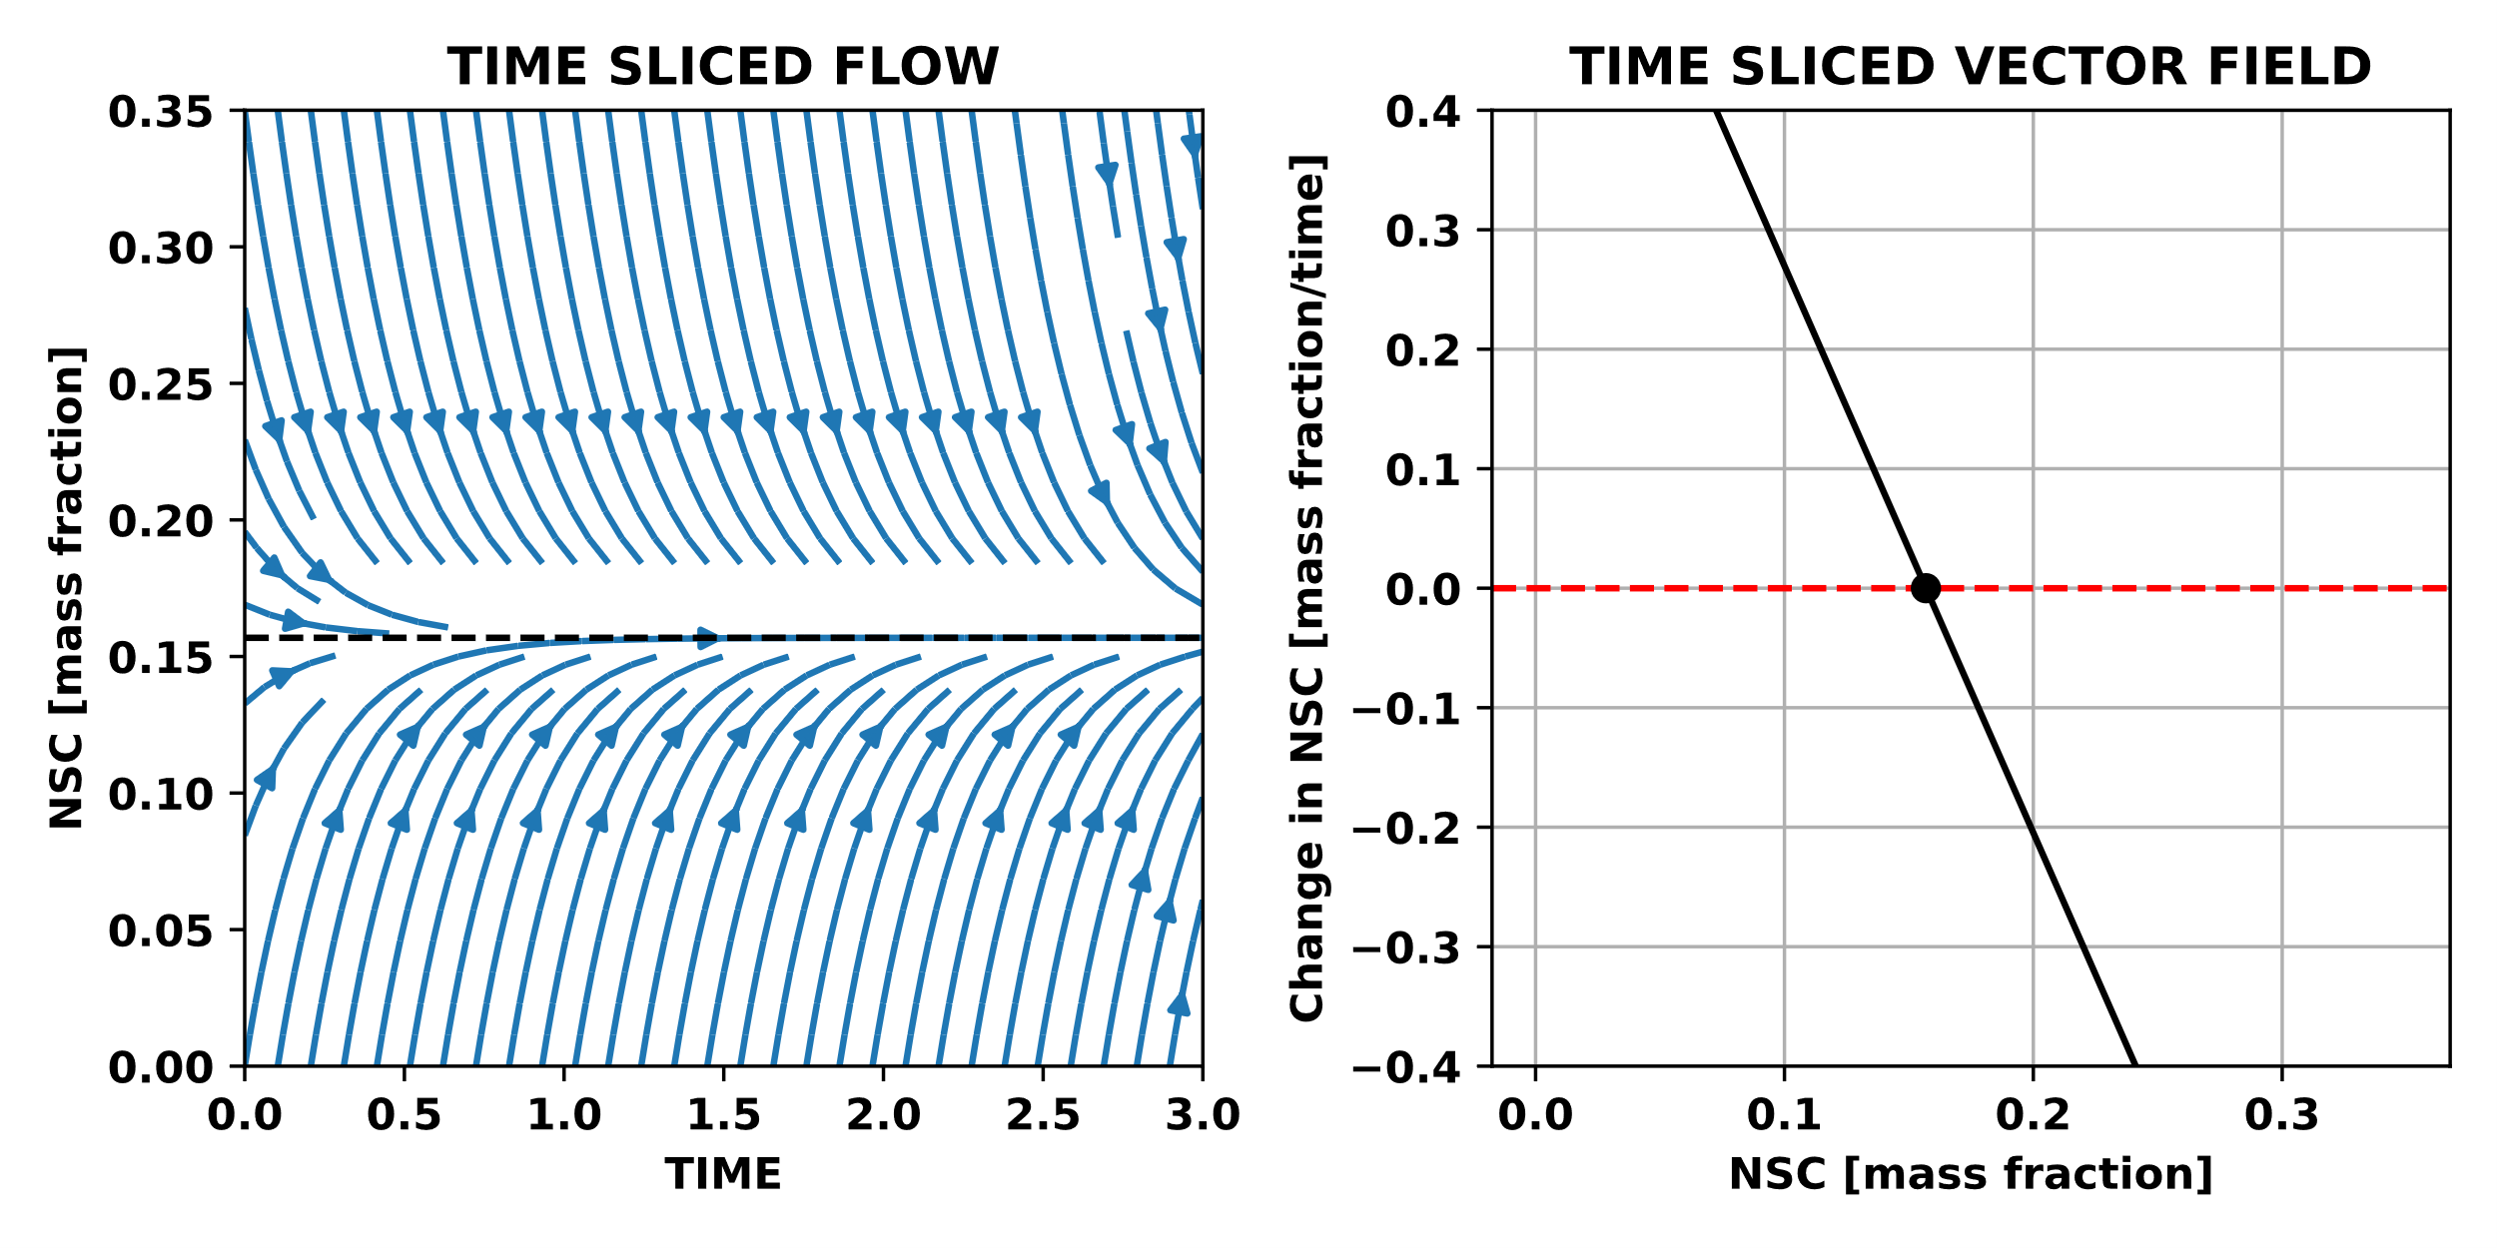
Balance point
Demand Rate
Rate
Supply Rate
Balance point
NSC

Slide 6
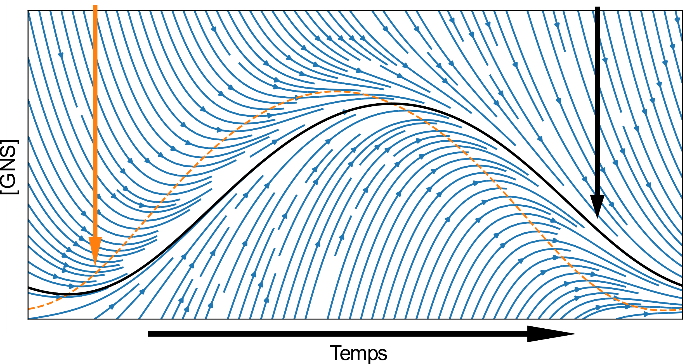
Balance point
Attractor
[NSC]
Time

Slide 7
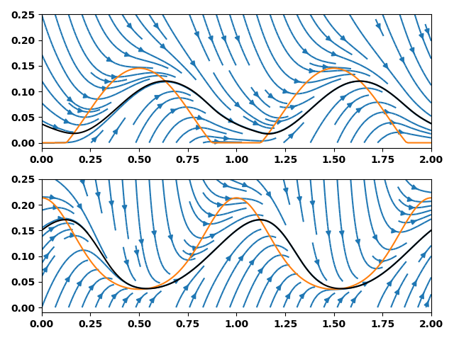
Balance point
Attractor
NSC (mass fraction)
Time (y)

Slide 8
Balance point
Attractor
NSC (mass fraction)
Time (y)

Slide 9
Mature Turkey Oak
(Quercus laevis)
Loblolly Pine Saplings (Pinus taeda)
Mature Longleaf Pine (Pinus palustris)

Slide 10
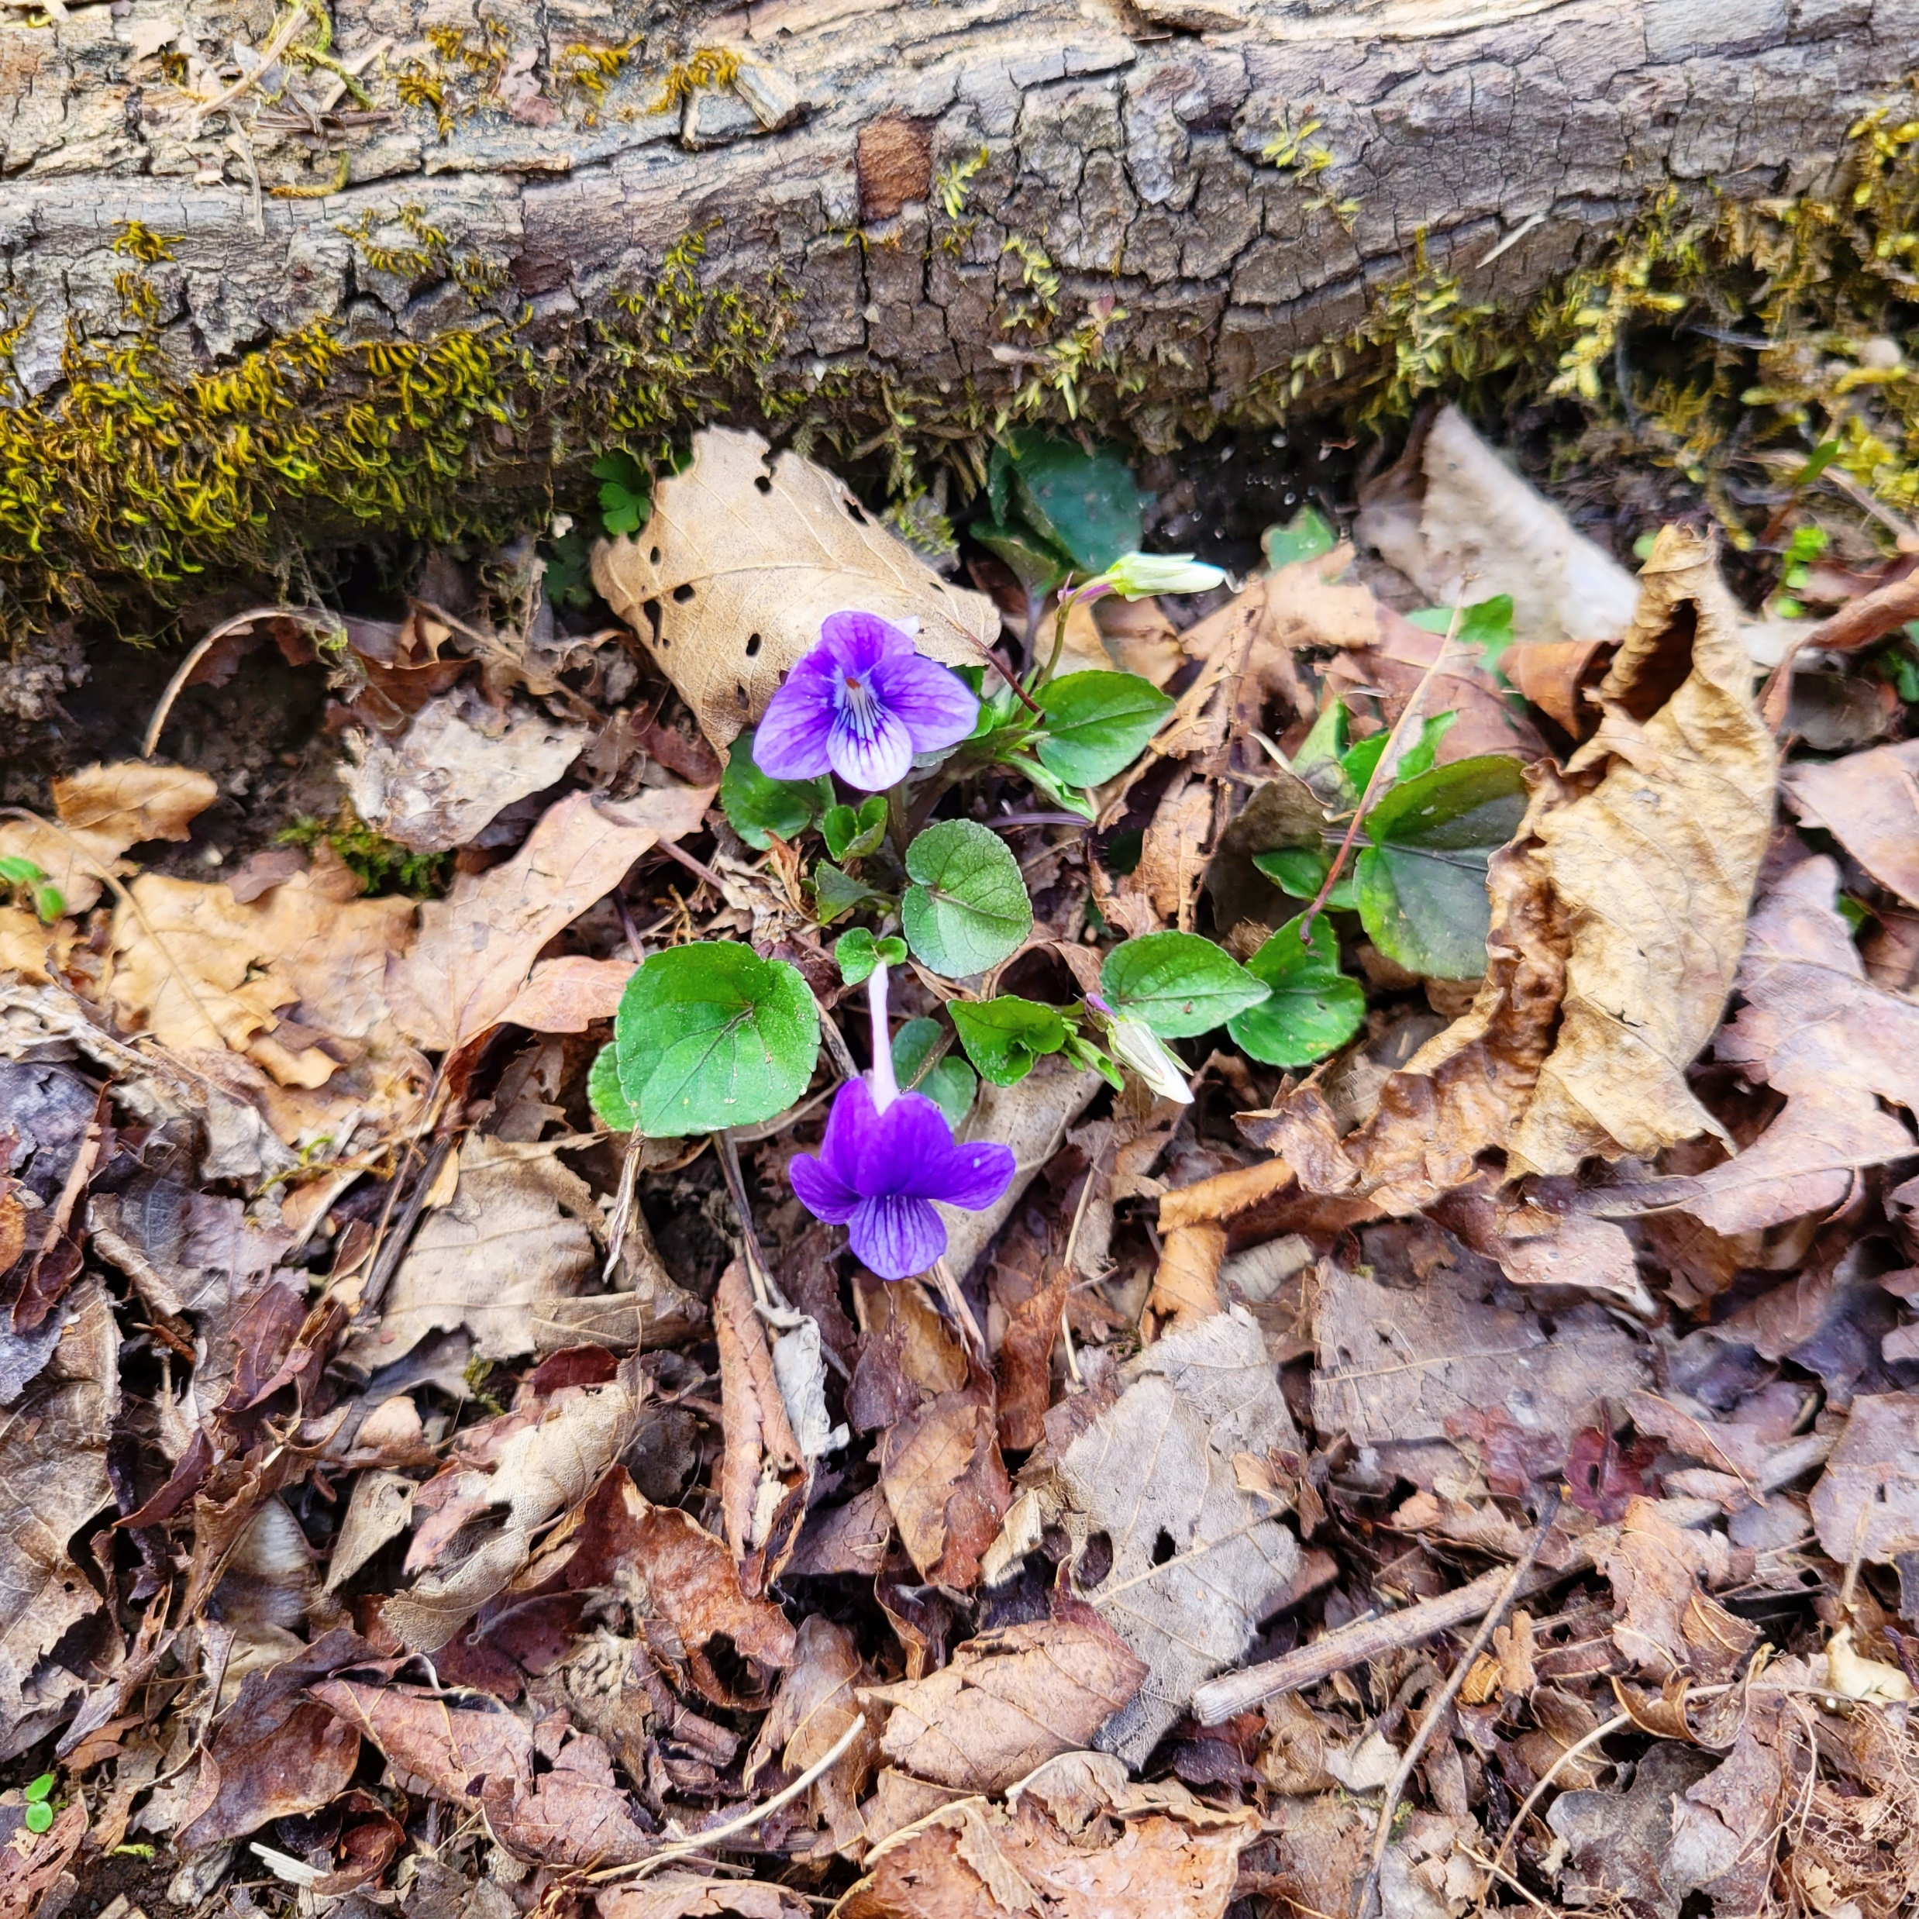
Summary
Photosynthesis = NSC supply
Adjustable
Demand Rate
Rate
Supply Rate
NSC
NSC
Respiration + Growth = NSC Demand

Slide 11
Balance point
Attractor
[NSC]
Time

Slide 12
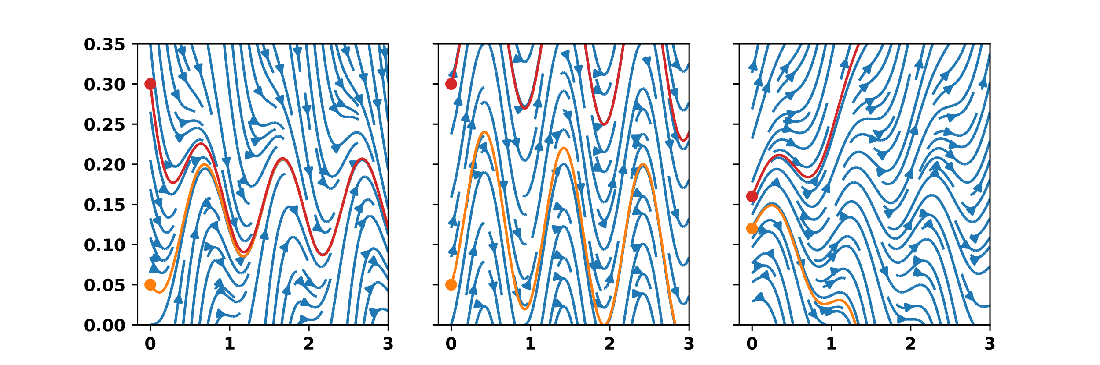
Stable
NSC (mass fraction)
Time (y)

Slide 13
Stable
Non Stable
NSC (mass fraction)
Time (y)
Time (y)

Slide 14
Stable
Non Stable
Unstable
NSC (mass fraction)
Time (y)

Slide 15
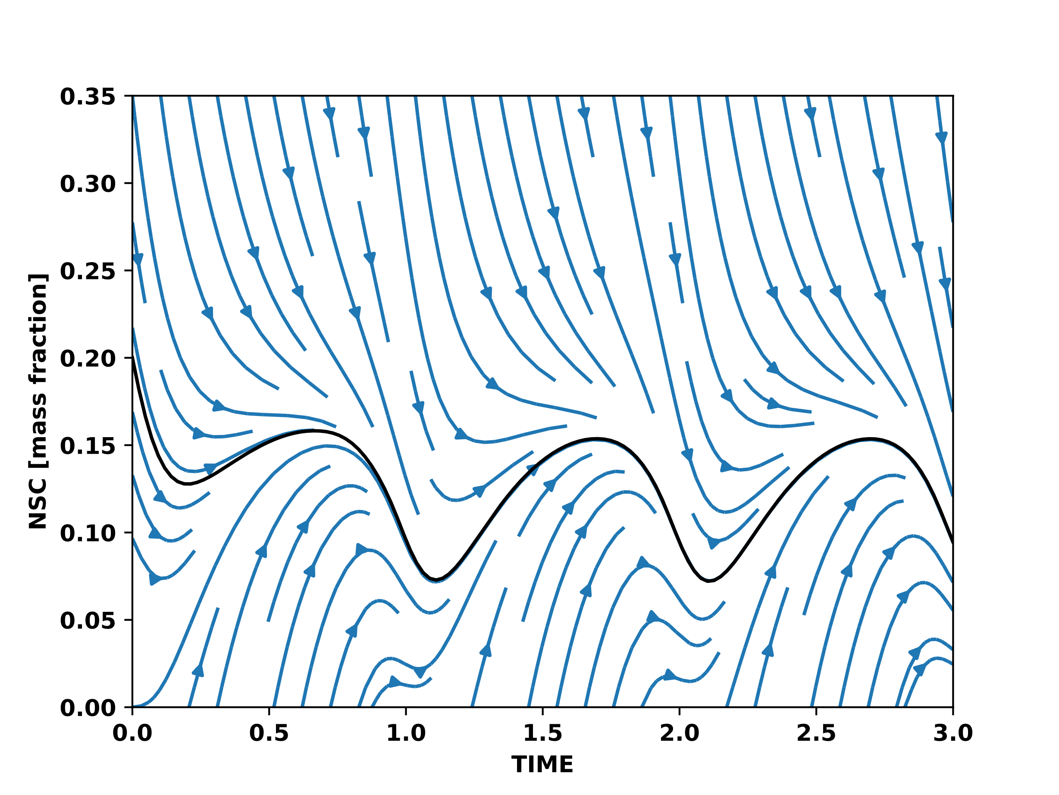
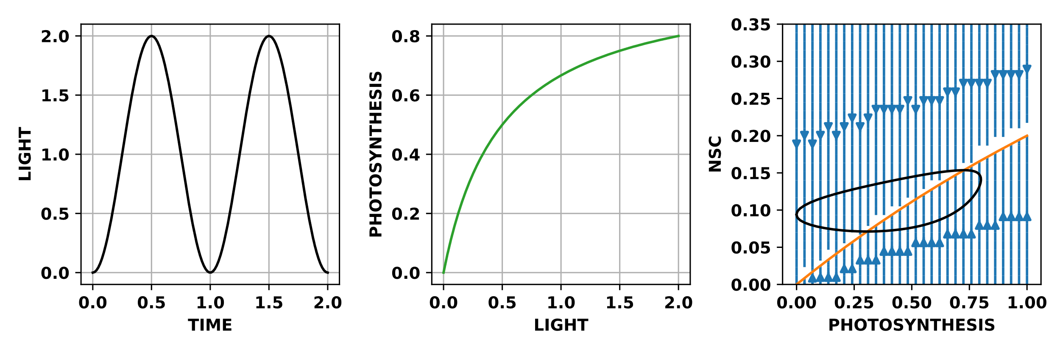
Stable for all environments

Slide 16
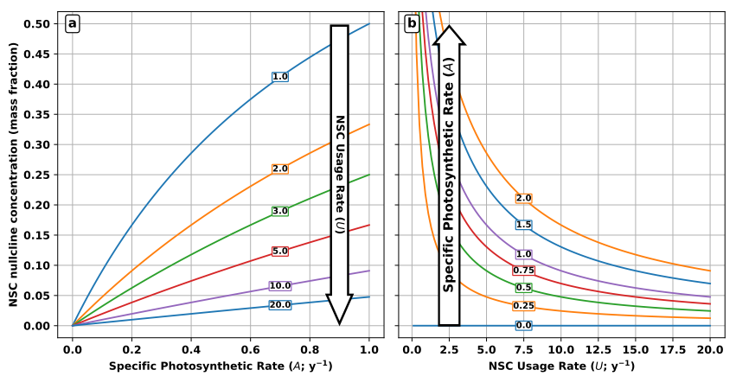
NSC balance point (mass fraction)

Slide 17
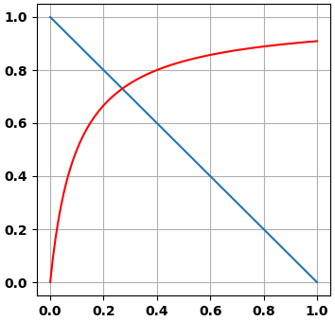
Photosynthesis
Adjustable
Rate
NSC
Respiration + Growth
NSC

Slide 18
Supply driven
Demand driven
Early growing season min
Late growing season min

Slide 19
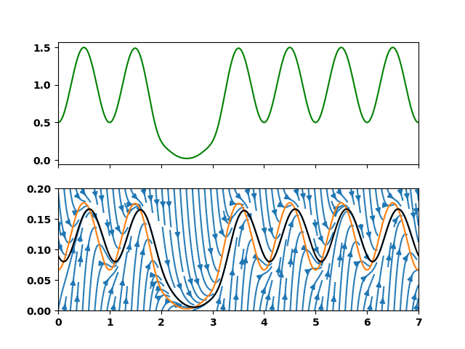
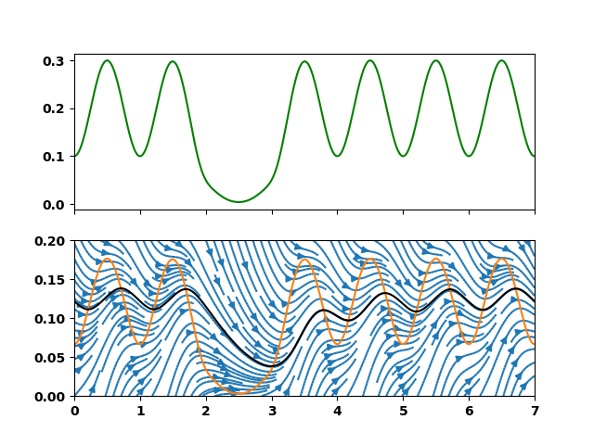
Supply rate
NSC (mass fraction)
Slower rate of supply and demand

Slide 20
NSC balance point (mass fraction)

Slide 21
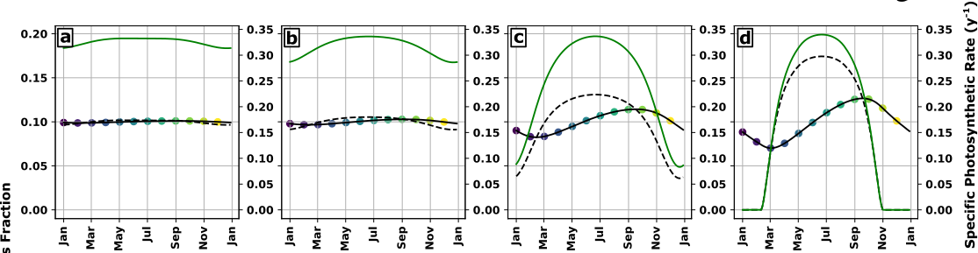
NSC (mass fraction)
Increasing seasonal amplitude of NSC supply

Slide 22
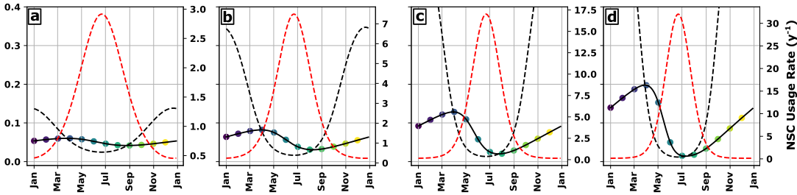
NSC (mass fraction)
Increasing seasonal amplitude of NSC demand

Slide 23
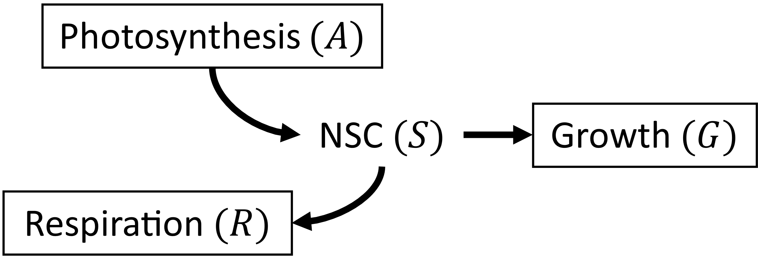
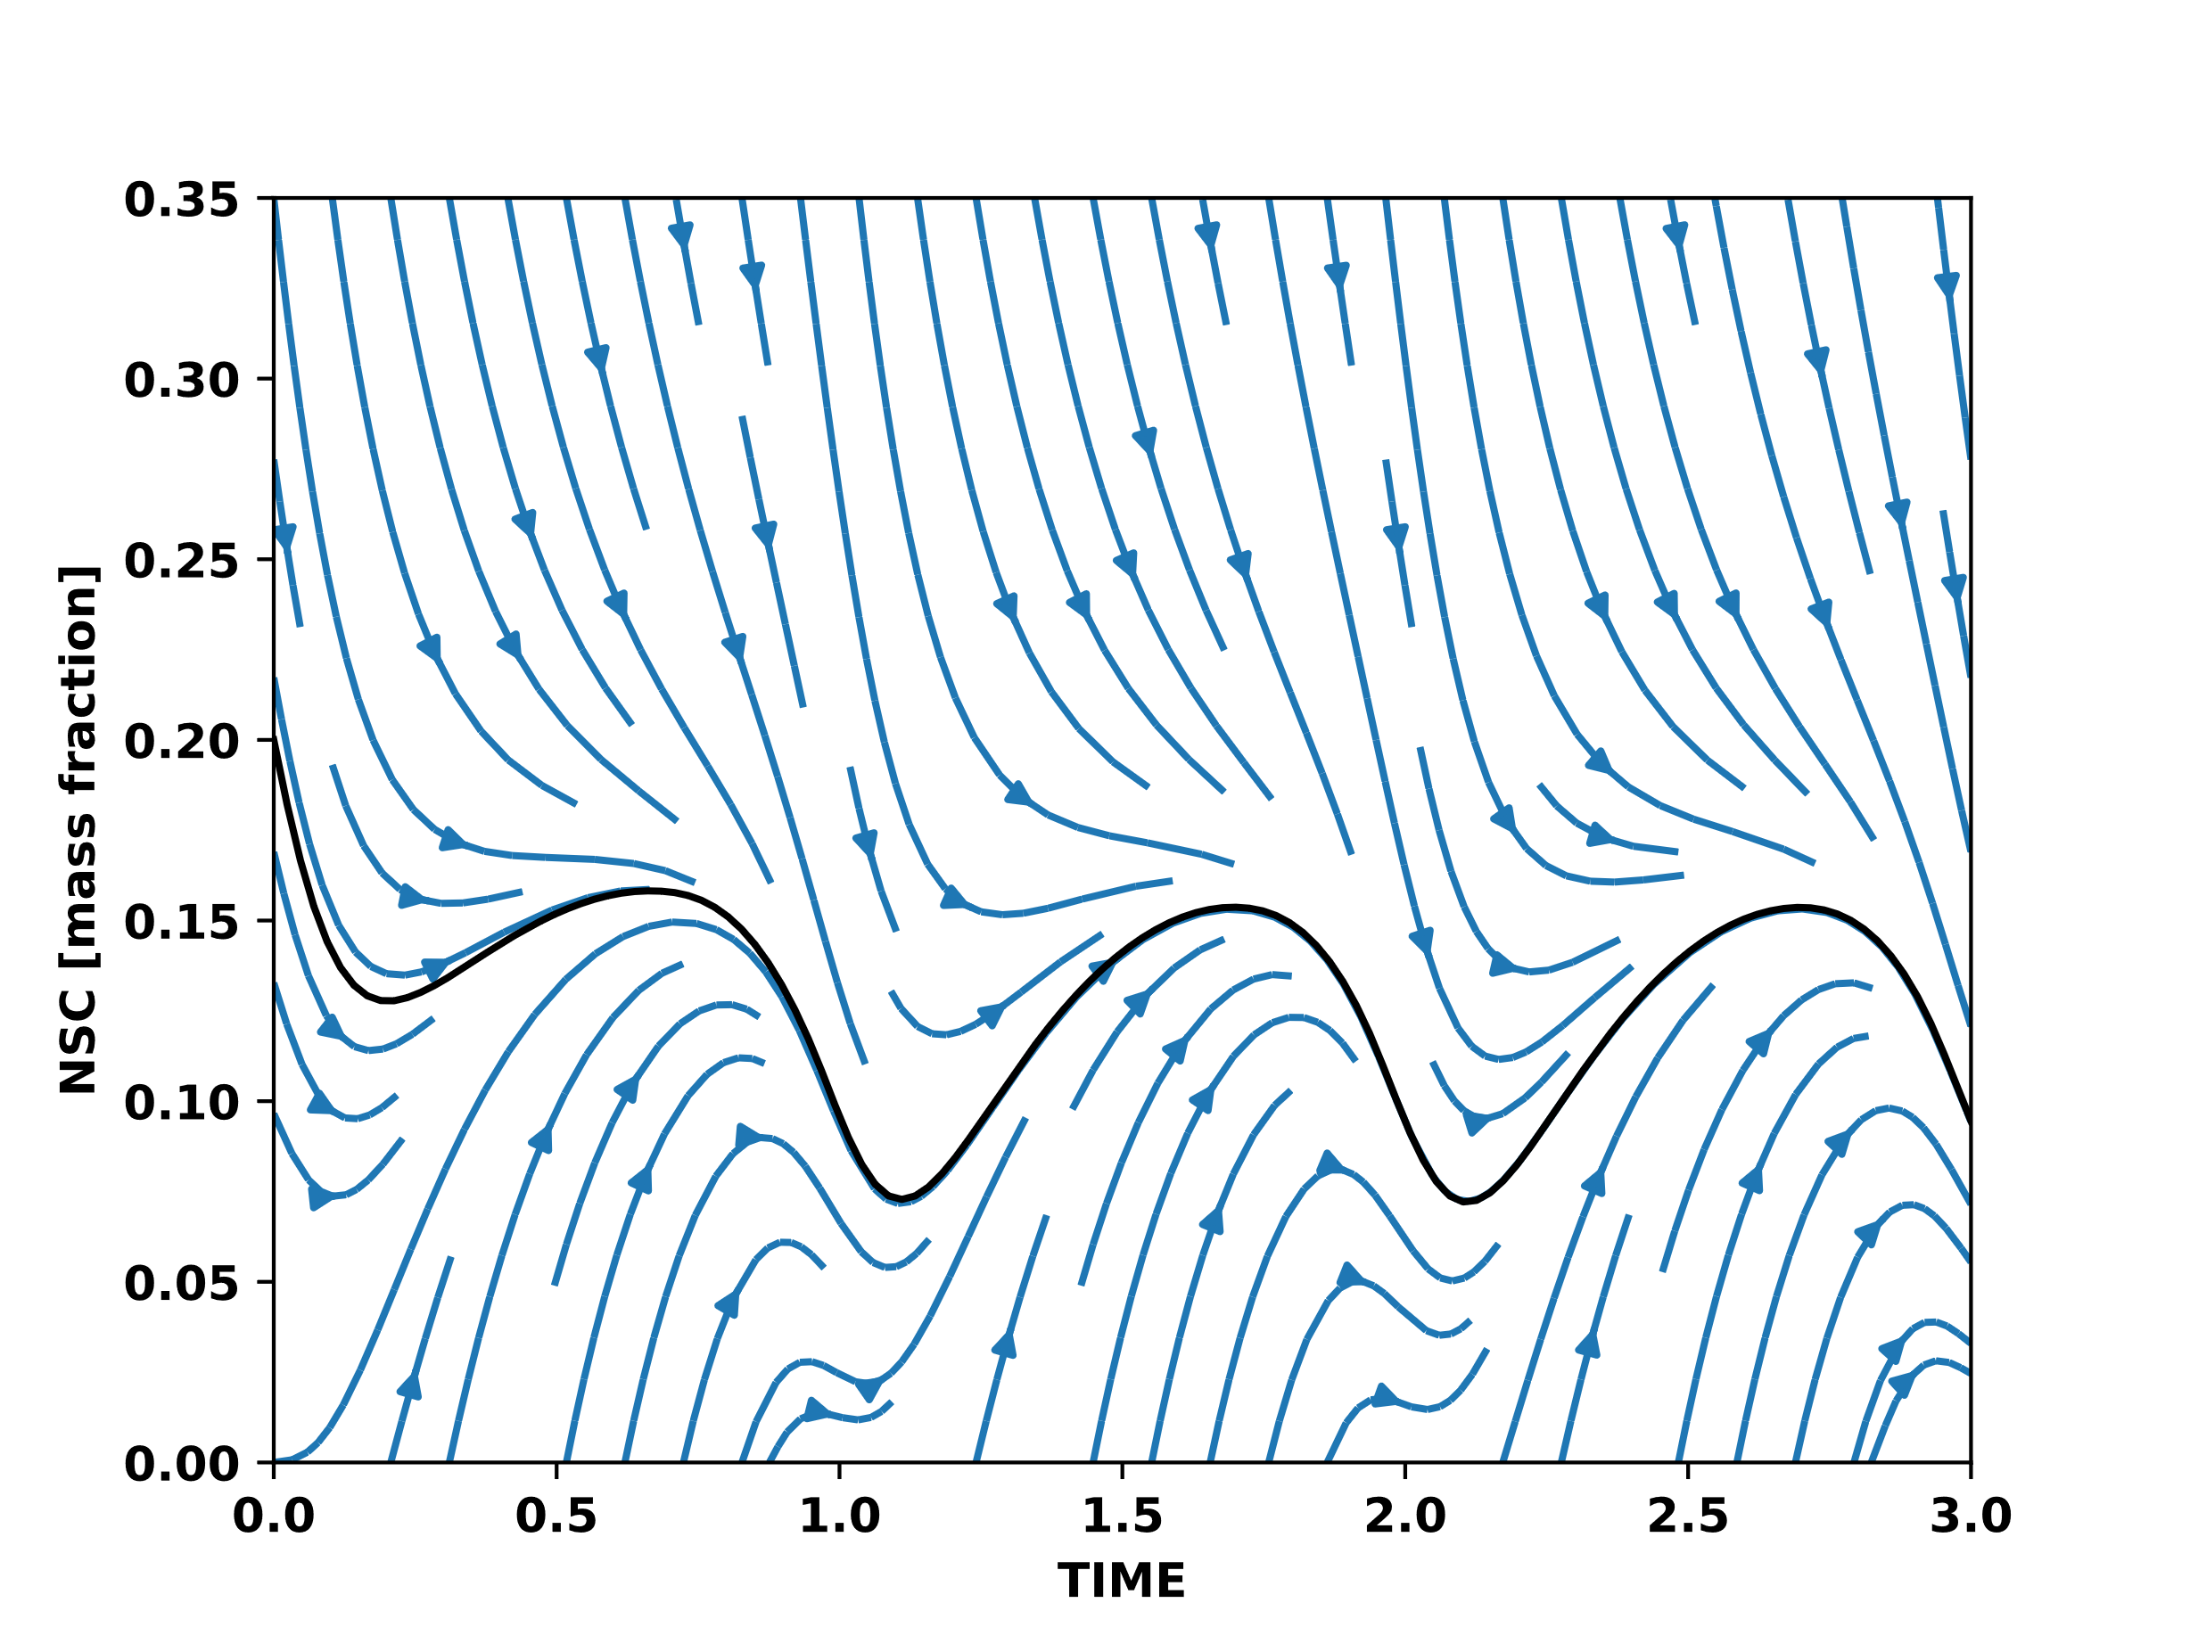
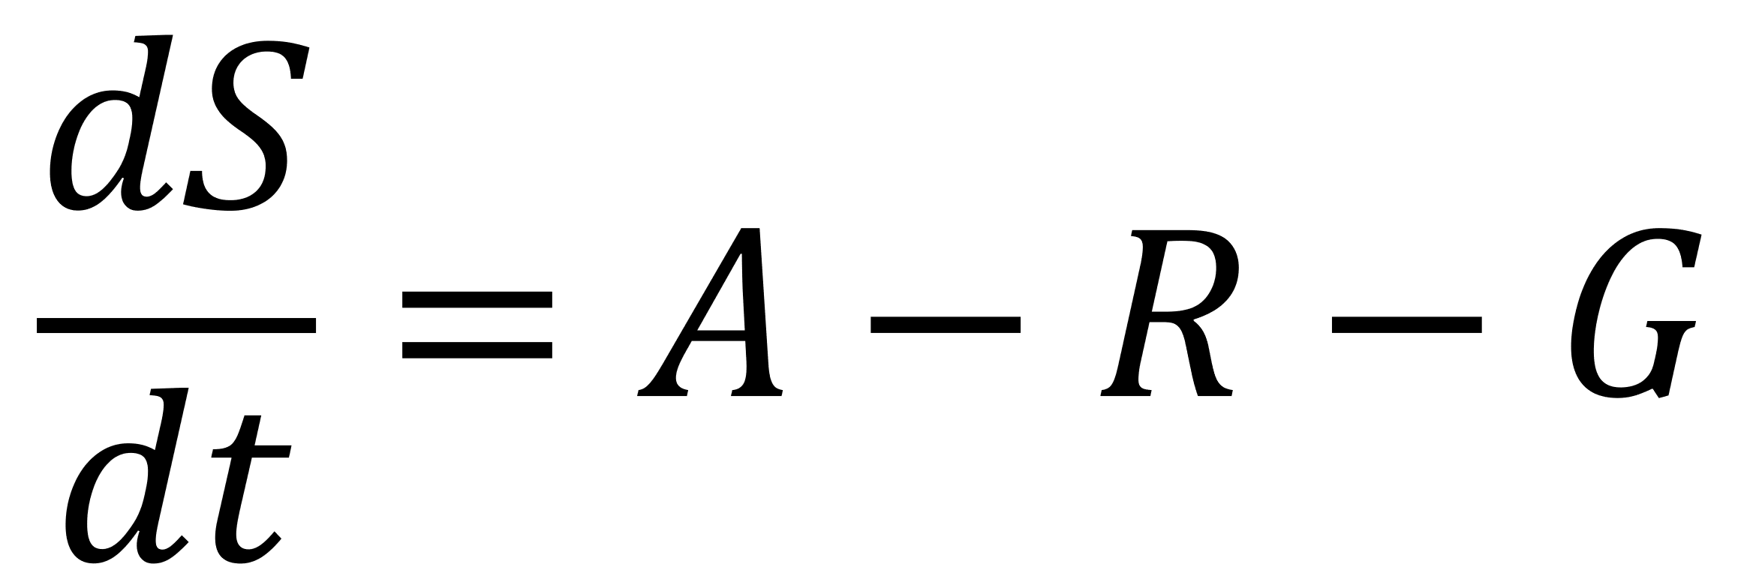
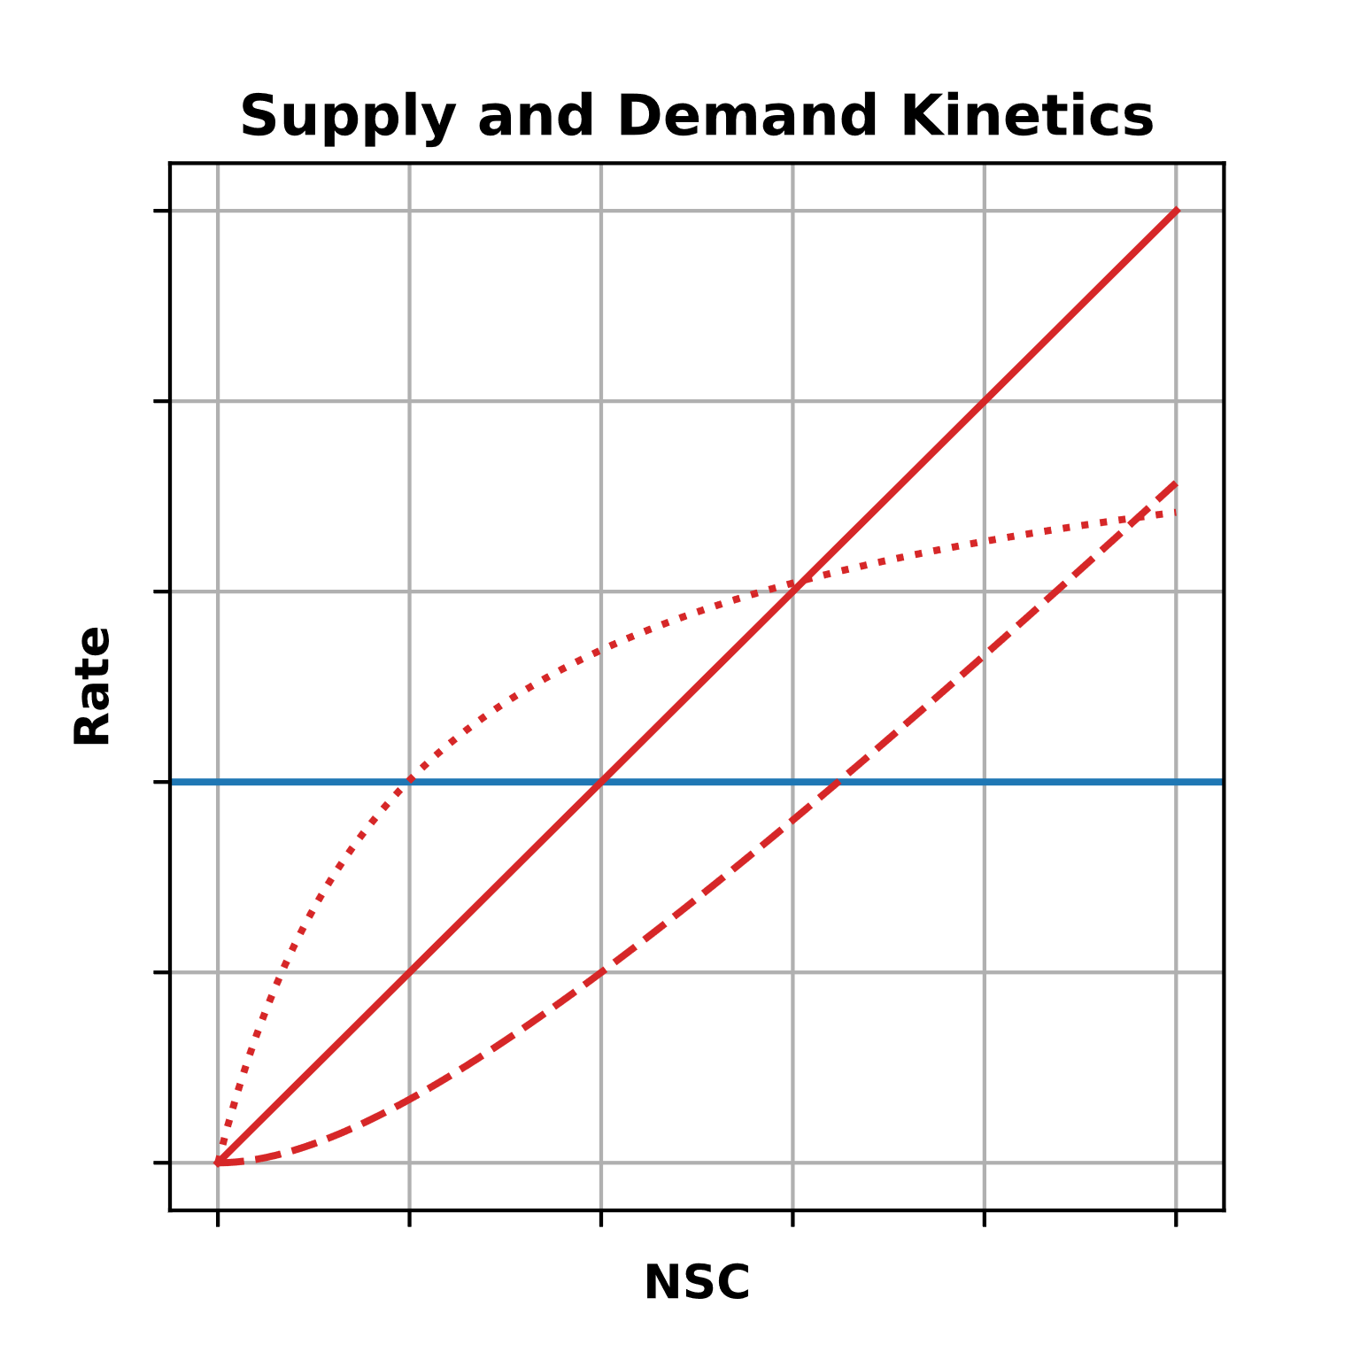

Slide 24
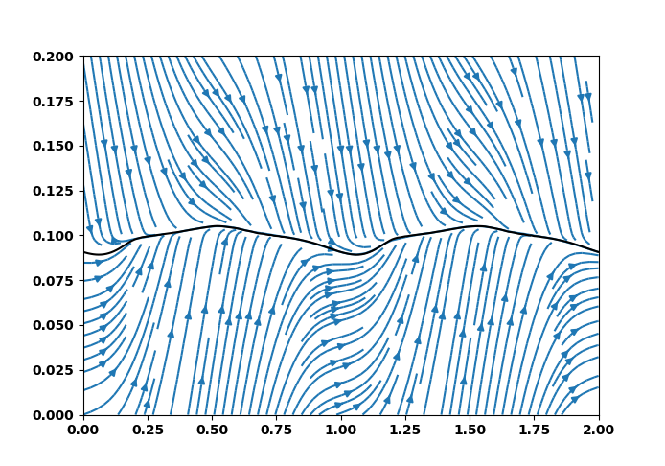
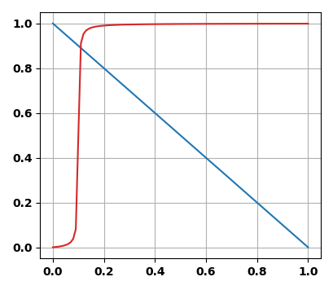
Homeostatic dynamics
Demand Rate
Supply Rate
NSC (mass fraction)
Time (y)

Slide 26
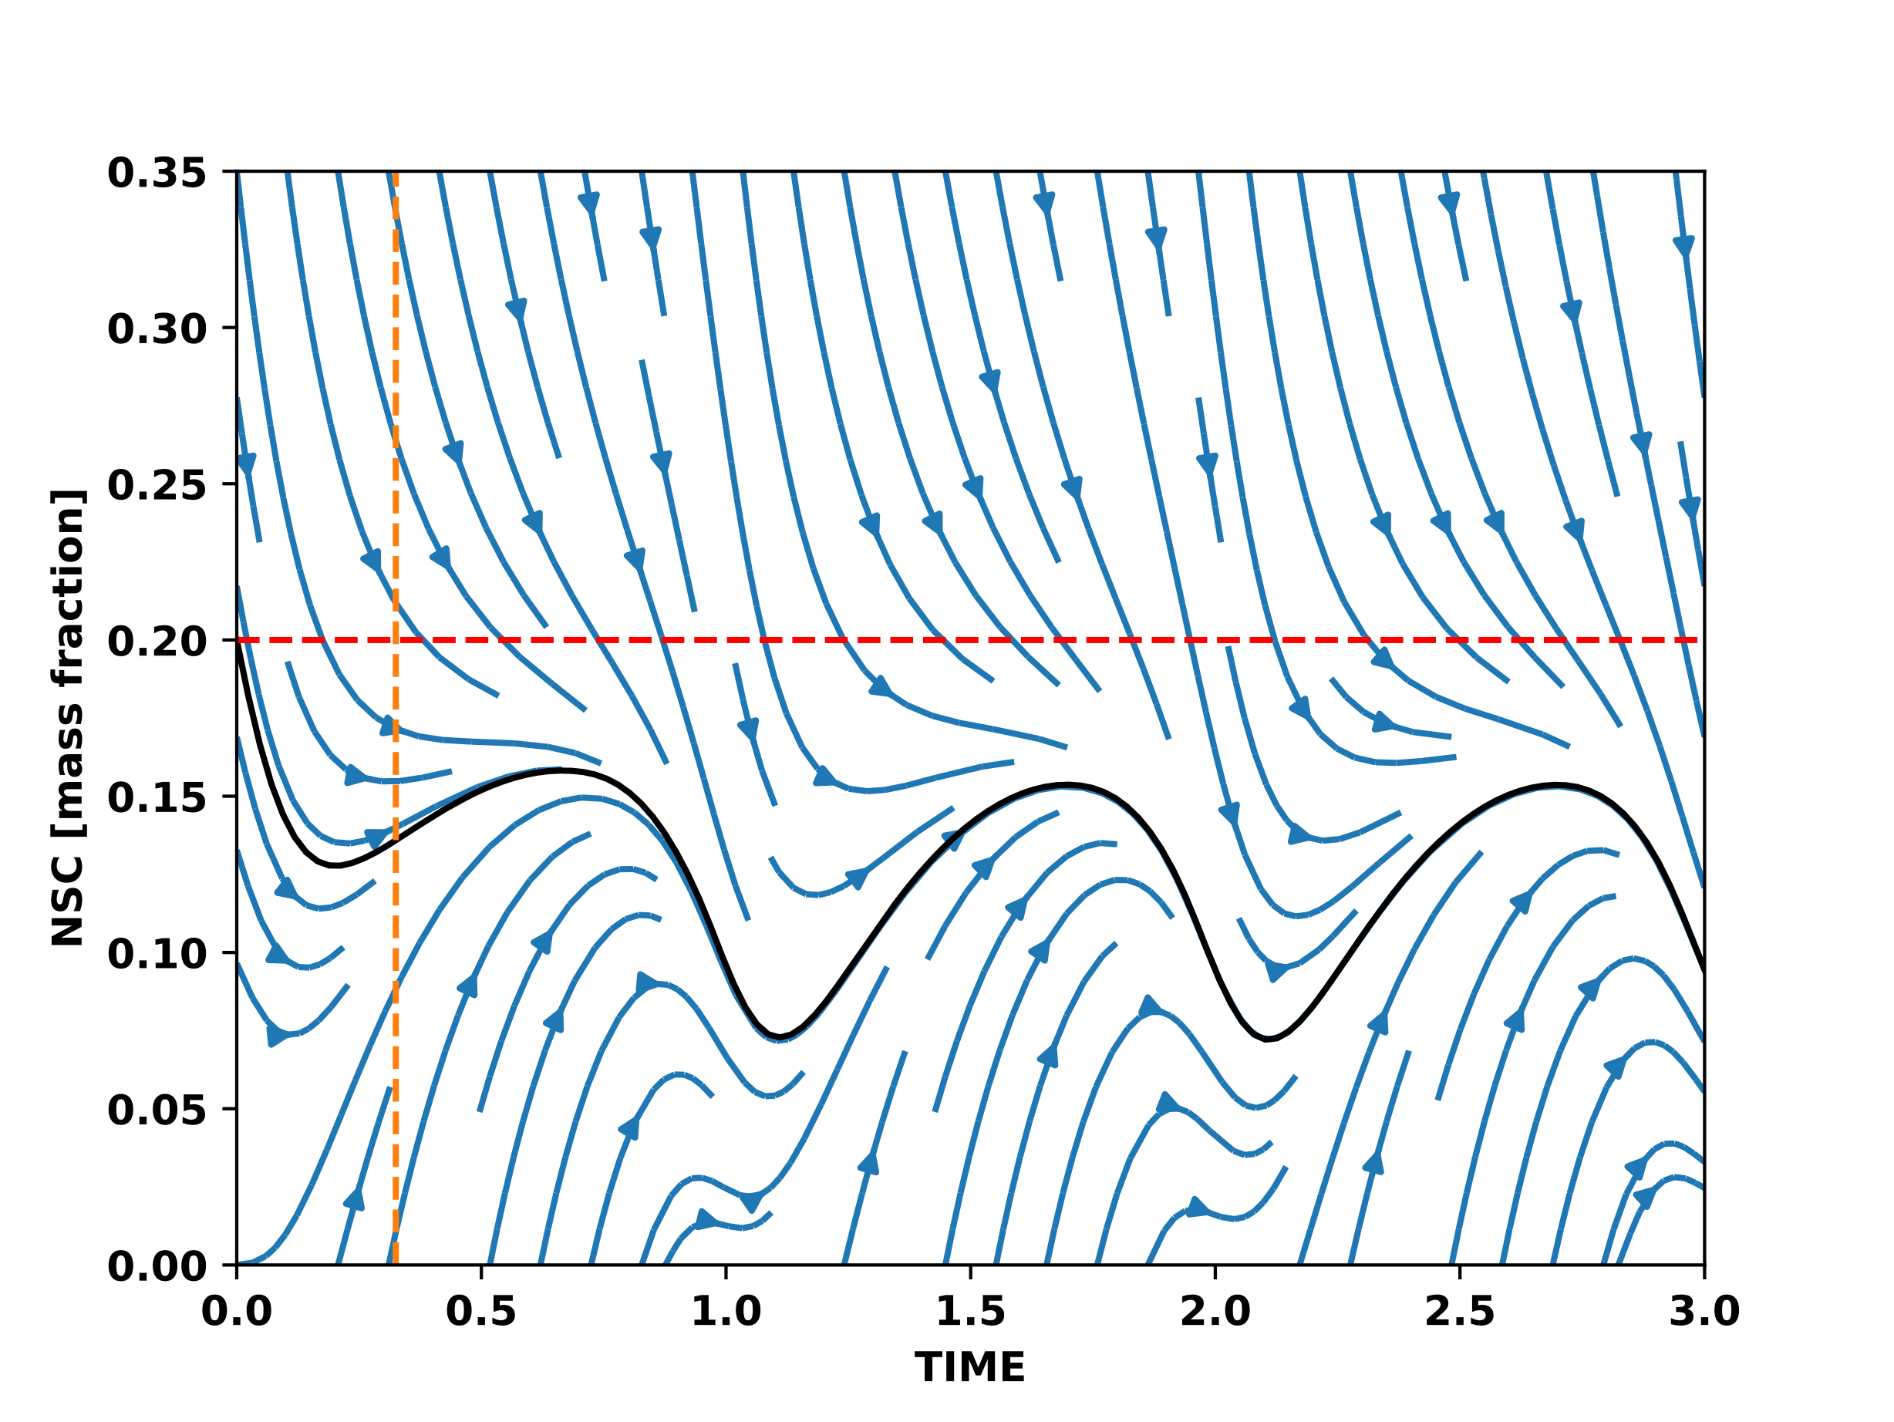
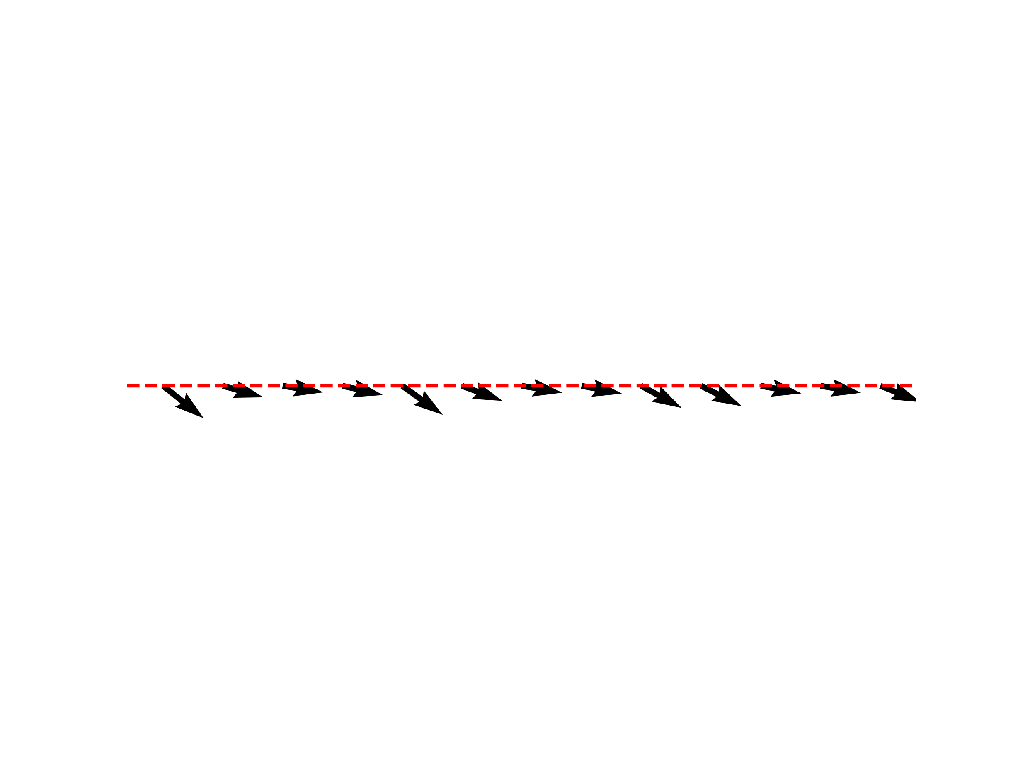
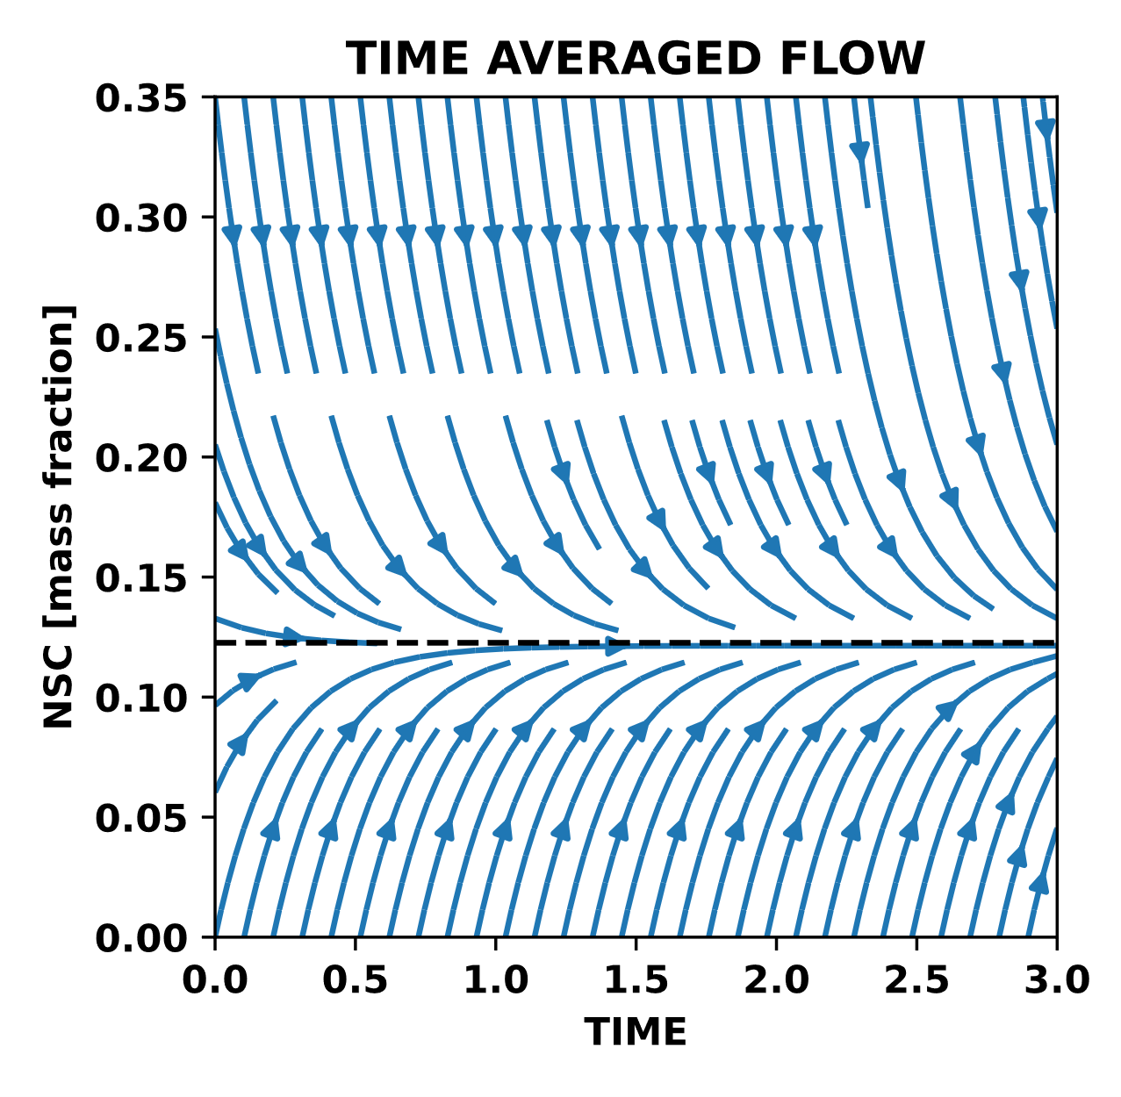

Slide 27
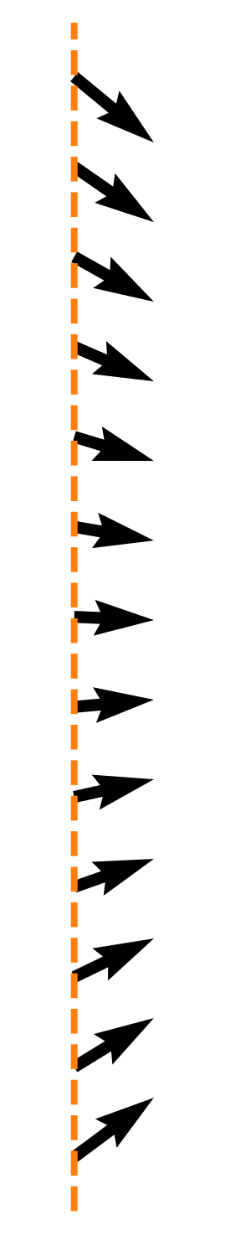

Slide 28
